Slide 1
Social Media Impact on Stock Market
Datalogy - Project Team:
Behnam Hashemi
Mohammad Ahmed Jilani
Gobinath Thangaiya
Yuvraj Singh Bhati
UofT Data Analytics Bootcamp Apr - Sep 2021

Slide 2
Introduction
A mastermind or a master manipulator?
In August 2018, Elon Musk used Twitter to claim he had "funding secured" to take Tesla private at a price of $420 per share.) → within 4hr → Tesla stocks increased $12 billion
He was challenged by the Securities and Exchange Commission (SEC), charged with fraud, fined $40m & had to step down as the Chairman of Tesla
In May 2020 he tweeted Tesla stocks share are a bit expensive → decreased 10%
Early February 2021 purchased $1.5-billion in Bitcoin to 'maximize returns on cash'
purchased $1.5-billion in Bitcoin to
Notes:
In May 2020, Musk tweeted that “Tesla's stock price is too high imo.” That day Tesla's stock price closed 10 percent lower than the day before.

Slide 3


.

Slide 4
Study Design, Objectives & Questions
One of the best method to measure effects of e.g. a medication on patients is to eliminate confounding factors and interpersonal differences
Method used in epidemiology is a case-crossover study
To analyze his tweets in a 10+ year period
To analyze the Tesla stock closing price on daily basis
Find any correlation between the tweets and the stock price changes

Slide 5
Data Sources
Elon Musk’s Tweets:
From January-September 2021 from Twitter API
A dataset of tweets from 2011-2020 from Kaggle
Reposts and Replies made by Elon Musk were excluded
Tesla Stocks:
Tesla stock price data from 2011-2021 from Yahoo Financial library

Slide 6
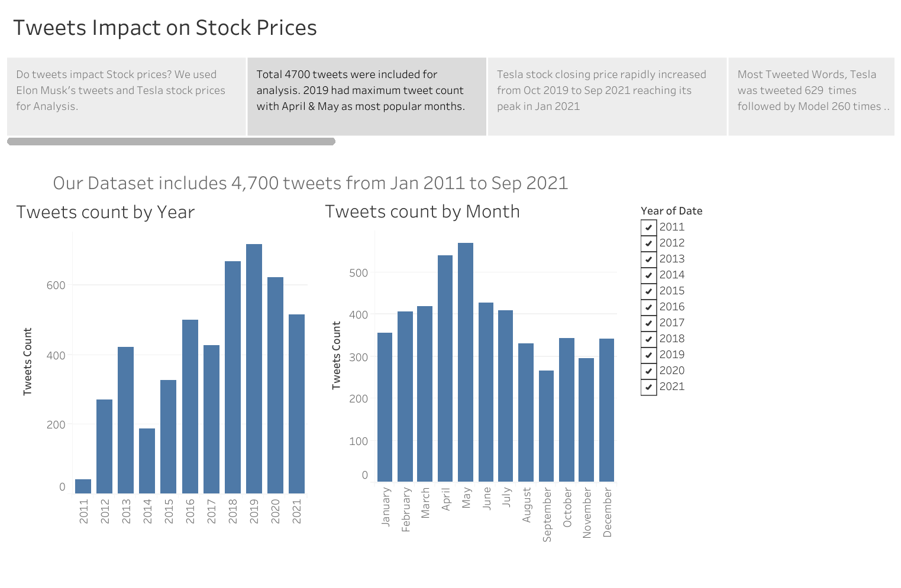
Number of Tweets increased since 2018

Slide 7
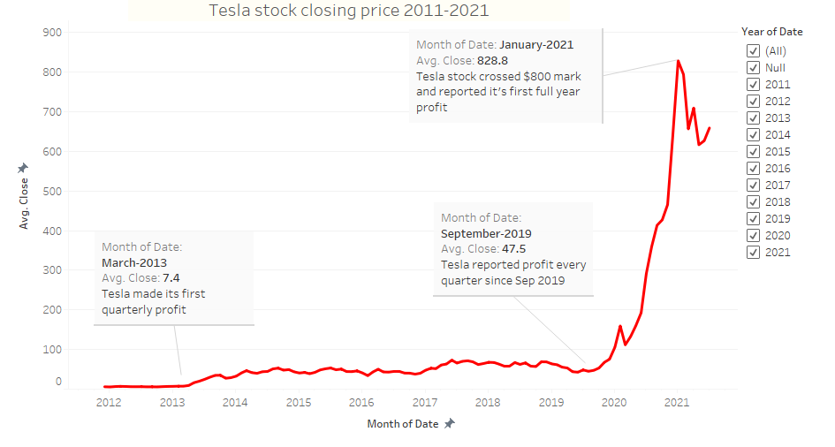
Tesla stock closing price 2011-2021

Slide 8
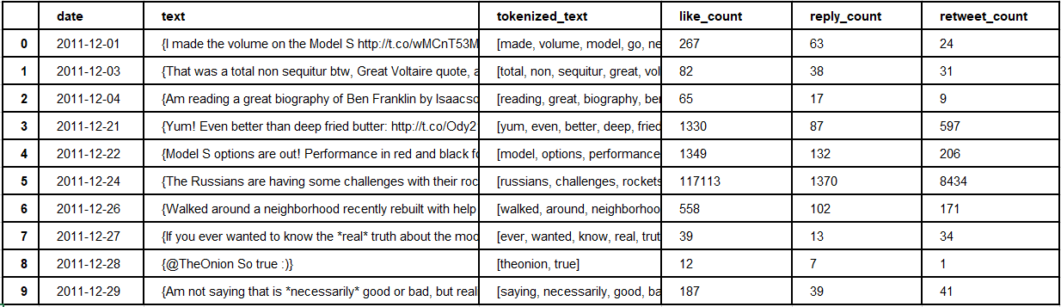
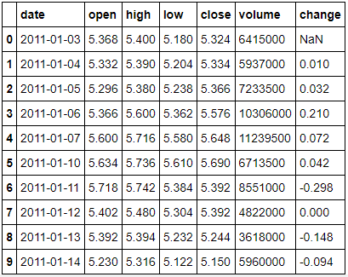
Data Preprocessing
NLTK Library:
Create a list of English Stop words, Tokenize and filter from the tweets
Porter Stemmer Algorithm:
Reduce words to their stem

Slide 9
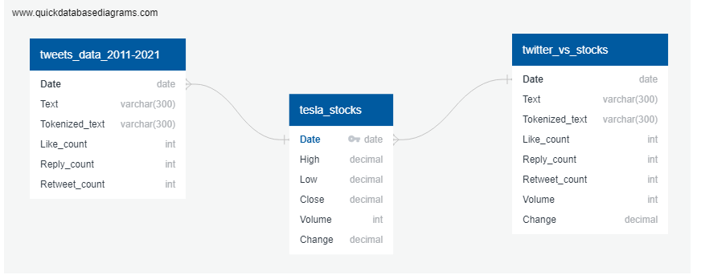
Database
SQL Alchemy was used to join the Twitter and Stock datasets
The combined dataset was posted to Postgres Database
Postgres database was linked to AWS RDS cloud platform

Slide 10
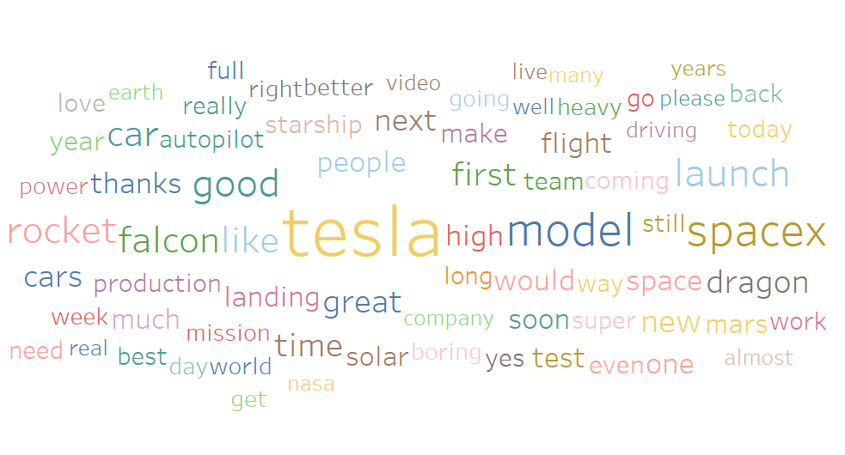
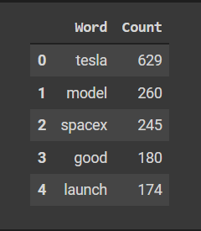
Most Tweeted Words by Elon Musk

Slide 11
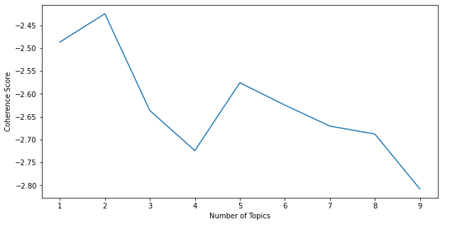
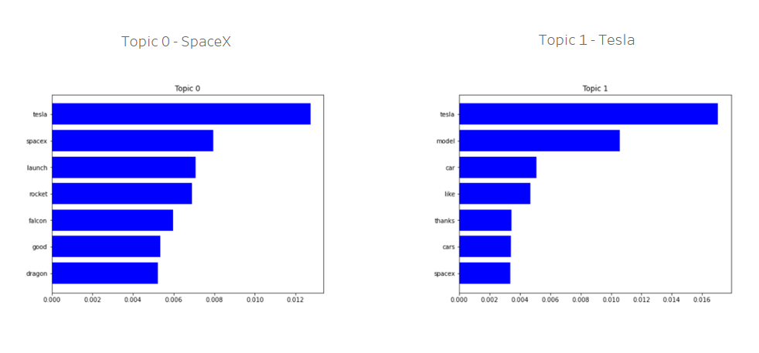
Latent Dirichlet Allocation (LDA) model shows two main topics

Slide 12
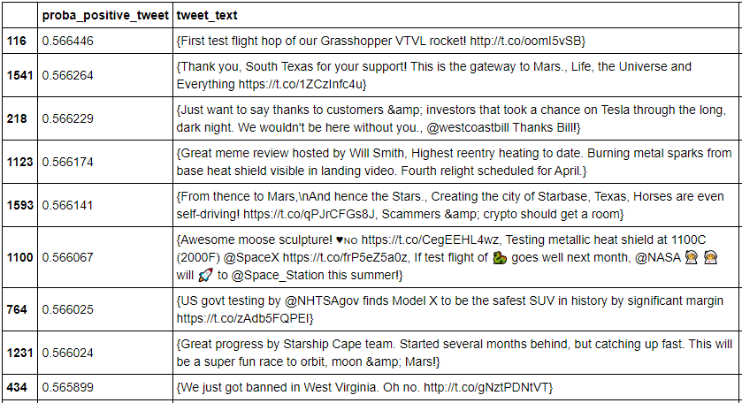
ML Classification model
The model was able to identify positive tweets using:
CountVectorizer = Takes in a list and counts how many times it appears, creating vocabulary of known words
TfidfTransformer = Frequency of word in a tweet as compared to other tweets
LogisticRegression = Classify impact of tweets on stock prices as positive or negative
The accuracy of the model was approx 55%

Slide 13
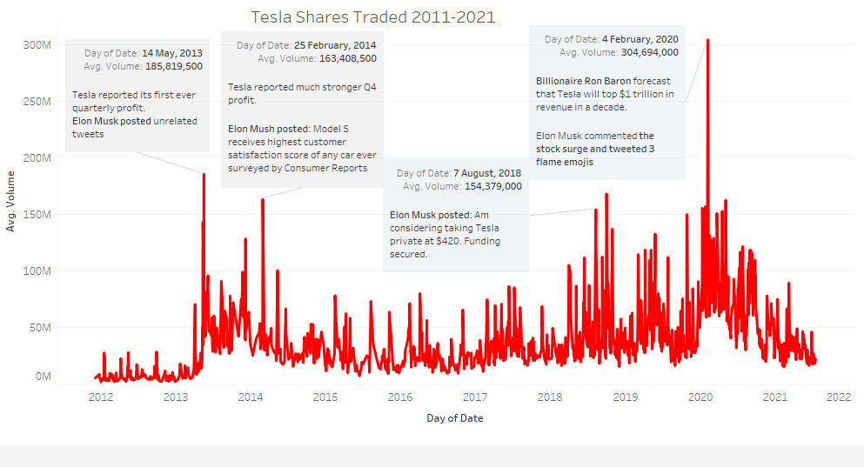
Tesla’s financial report, forecasts and tweets impacted trading volumes

Slide 14
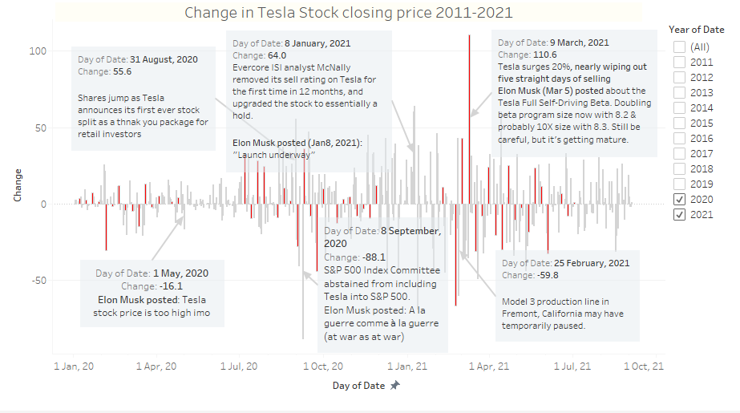
Highest increase on 9th Mar 2021 and highest decrease on 8th Sep 2020

Slide 15
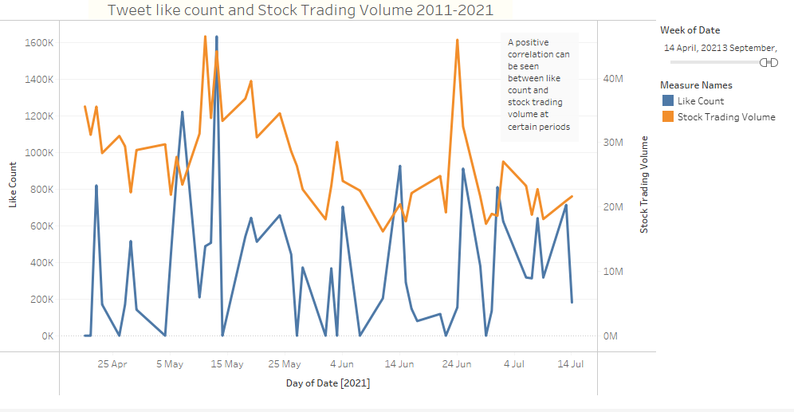
Positive correlation found in like count and stock trading volume at certain periods

Slide 16
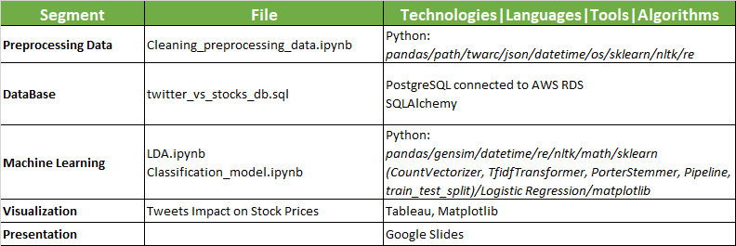
Project Segments, Files and Technologies Used

Slide 17
Conclusion
ML model shows weak correlation between tweets and fluctuation in stock price as shown by 55% accuracy result
LDA model shows Elon Musk’s tweets are heavily focused on his interests on subjects like: Tesla, SpaceX and related topics
Stock market is influenced by an array of factors and social media does influence certain trends but they are short term

Slide 18
Recommendations for Future Analysis
Assess the influence of Elon Musk’s tweets on Cryptocurrencies
Apply this model to other individuals with greater public influence
Based on positive correlation, apply this model to assess the influence of likes and retweets on changes in stock prices

Slide 19
Questions?

